Slide 1

Programming Technique III Project Player Scouting Management System USER MANUAL
By: Group Catchy
Lecturer: Mohd Shahizan Bin Othman

Slide 2

Content
Team Member Page 3
Project Overview Page 4
User Manual Page 5
Register Page Page 6
Login Page Page 7
Country List Page 8-9
Player List by Selected Country Page 10
Search Player Page 11-12
Player Information Details Page 13
Edit Player Information Details Page 14
Create Player Page 15
Create Match Page 16

Slide 3

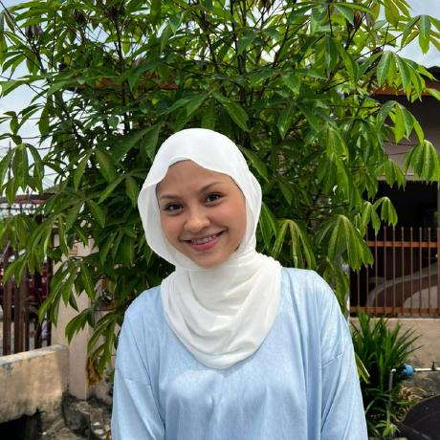


Team Member
Name: Muhammad Zunnur Bin Mohd Suhaimi
Matric Number: SX180425CSJS04
Github Profile: https://github.com/zunnurs01
Name: Wan Atrisyia Binti A’Abidin
Matric Number: SX180875CSJS04
Github Profile: https://github.com/eisyaaaa
Name: Muhammad Akmal Bin Mohd Razali
Matric Number: SX180407CSJS04
Github Profile: https://github.com/akmalraz
Name: Nur Syahmir Rafiq Bin Rahim
Matric Number: SX171517CSJF04
Github Profile: https://github.com/syahnmir123

Slide 4
Project Overview
Every students has been assigned to program a project. Theme that were given by lecturer is FIFA World Cup. Hence, it has been decided among groupmates to create a project called Player Scouting System.
The purpose of this system is to manage list of player’s data including their personal information details, country that they playing for. This system also manage player and match creation where the person in charge can manage all information throughout the tournament.

Slide 5
User Manual
As we acknowledge, user is the main reason why this project is being develop. Not all user know how to use system. Hence, we built this system in a user friendly ways for them to use.
The purpose of this user manual is to help them understand more on how to use this system wisely. In this section, we will be providing steps on how to use the system along with functionality that existed in each module.

Slide 6
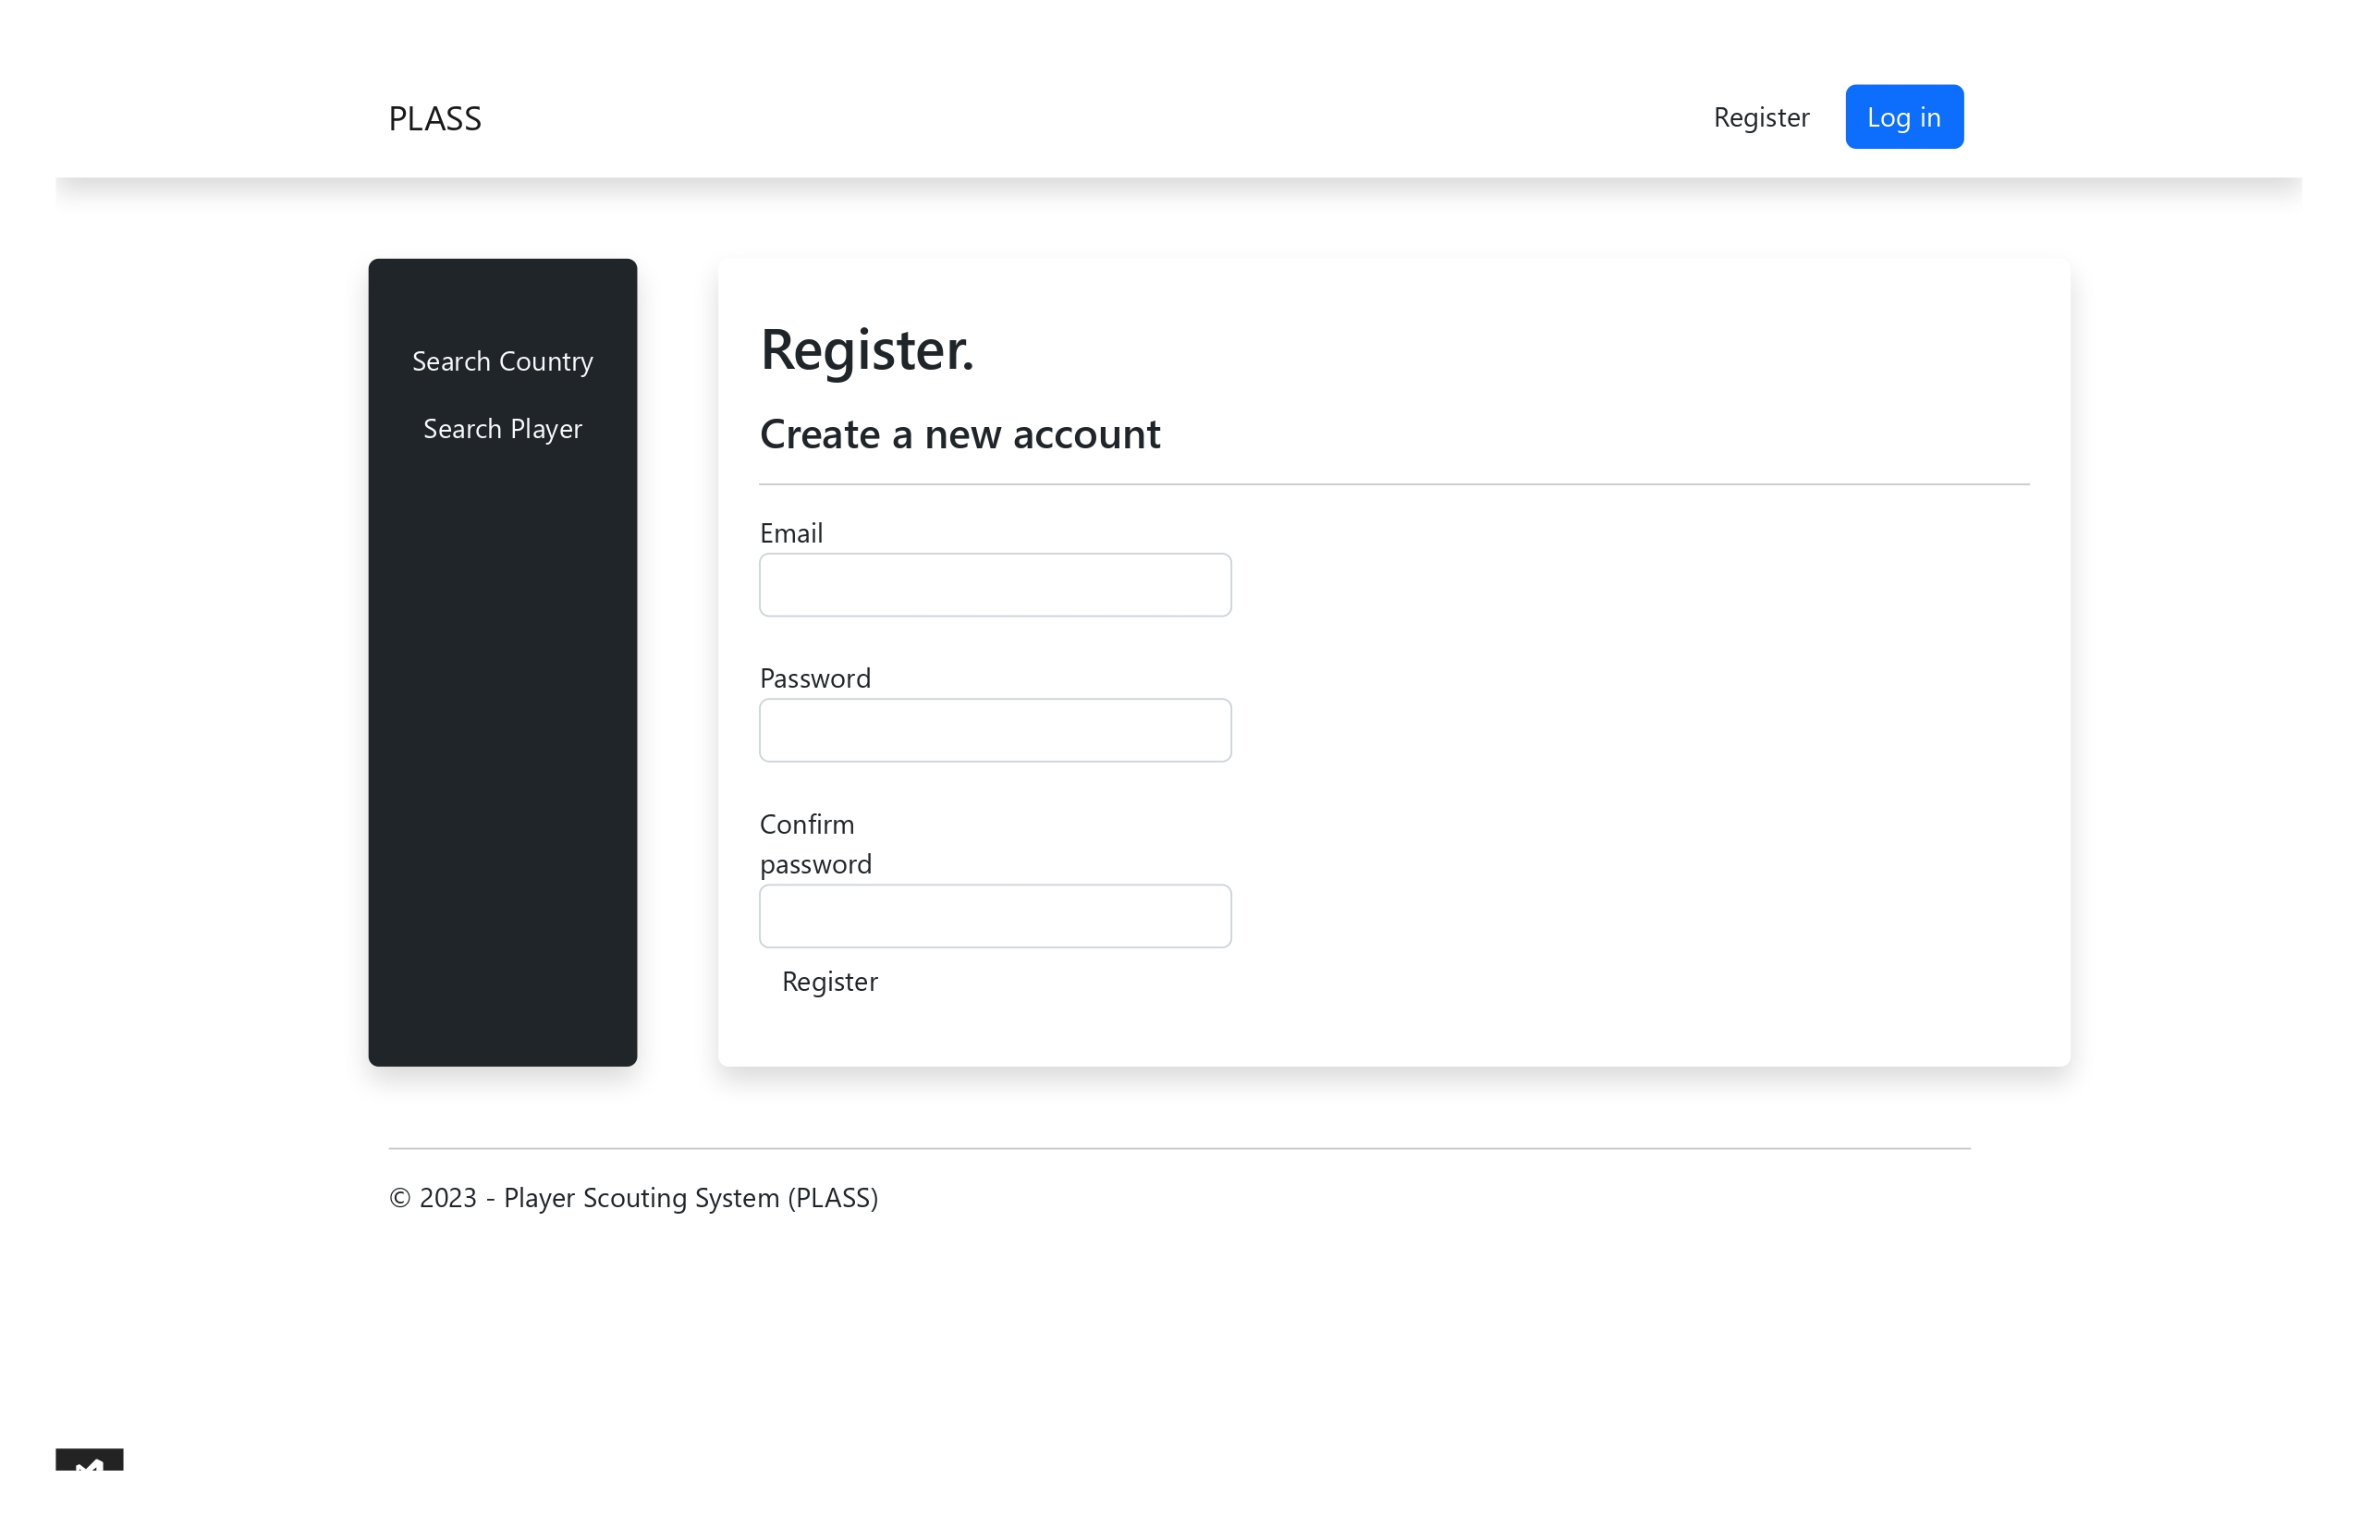
Register Page
To sign in account in order to access this system
To search country that participate in FIFA World Cup
To register account in order to access this system
1
To search player that participate in FIFA World Cup
Steps to register an account
Insert Email
Insert Password
Insert inserted password based on number 2
Click Register
2
3
4

Slide 7
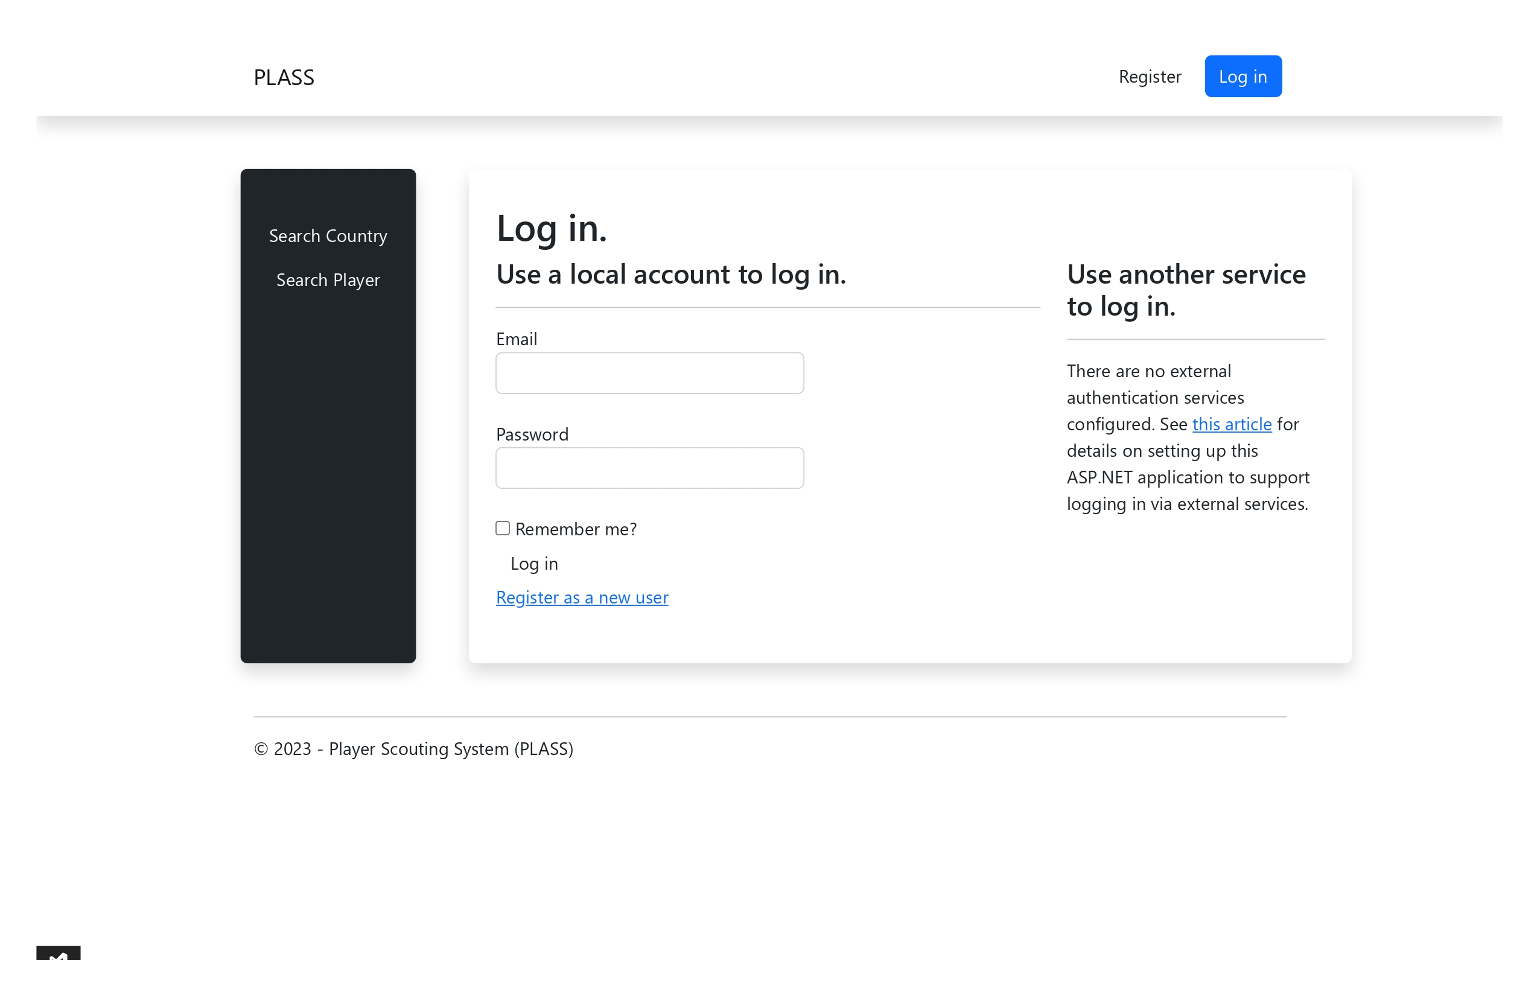
Login Page
To sign in account in order to access this system
To search country that participate in FIFA World Cup
To register account in order to access this system
Redirect to article of support services
1
To search player that participate in FIFA World Cup
2
Steps to log in
Insert registered email
Insert registered password
Click Log In
3
User may click this to register into the system in case user does not have any account yet
User may click checkbox for remember me for future login

Slide 8
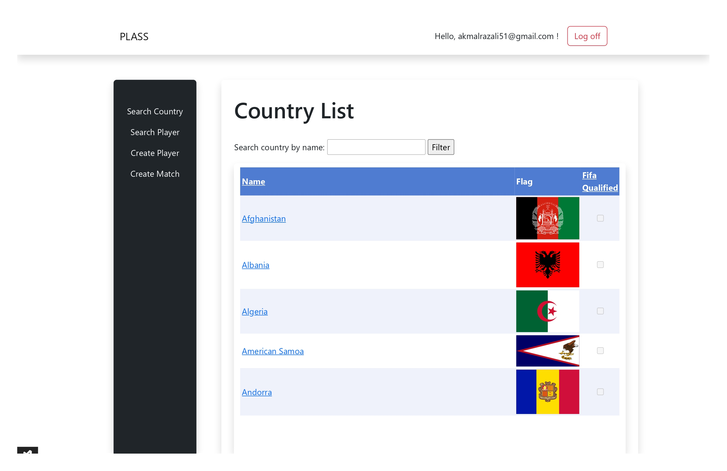
Country List Page (1/2)
Display user of the system
To search country that participate in FIFA World Cup
User able to log out from the system
1
2
To search player that participate in FIFA World Cup
Steps to search country
Insert country name
Click Filter
Create new player for any particular country
User can select the checkbox if the country qualify for FIFA World Cup
Create new match information for any player that participate in this tournament
Click country name to view country details page

Slide 9
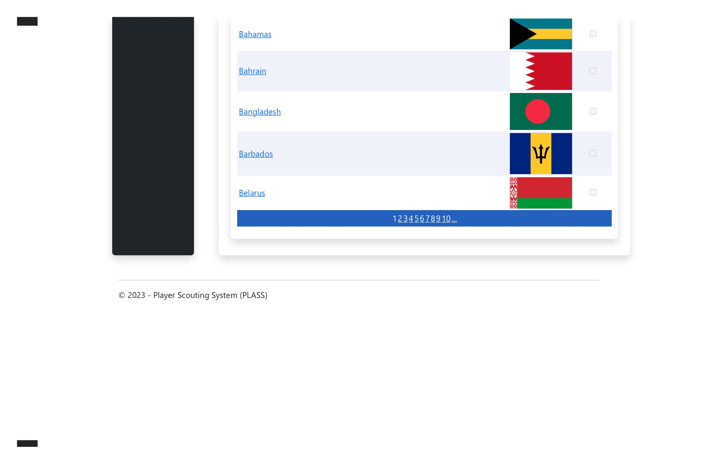
Country List Page (2/2)
User can view the next page by click pagination that were display in this page

Slide 10
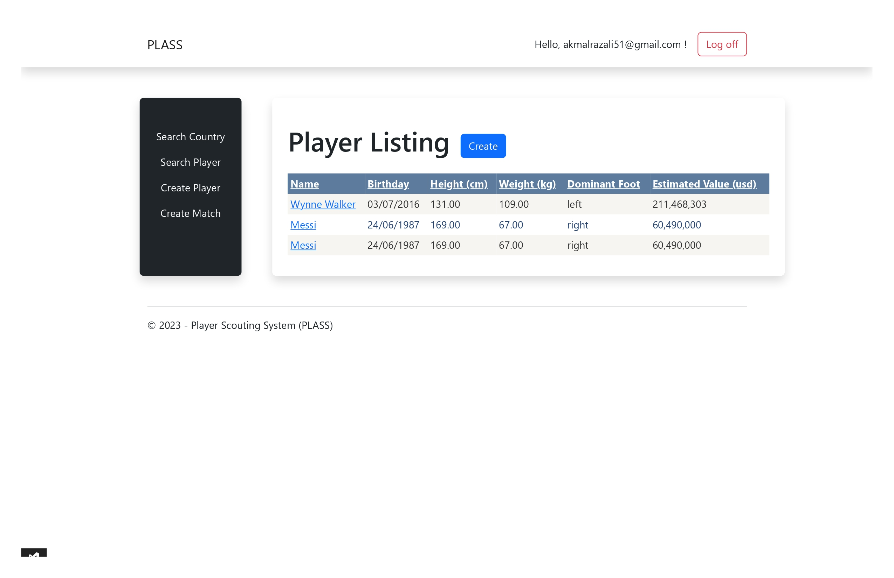
Player List by Selected Country
To search country that participate in FIFA World Cup
Click create to create new player of the country
To search player that participate in FIFA World Cup
Click player’s name to view player information
Create new player for any particular country
Create new match information for any player that participate in this tournament

Slide 11
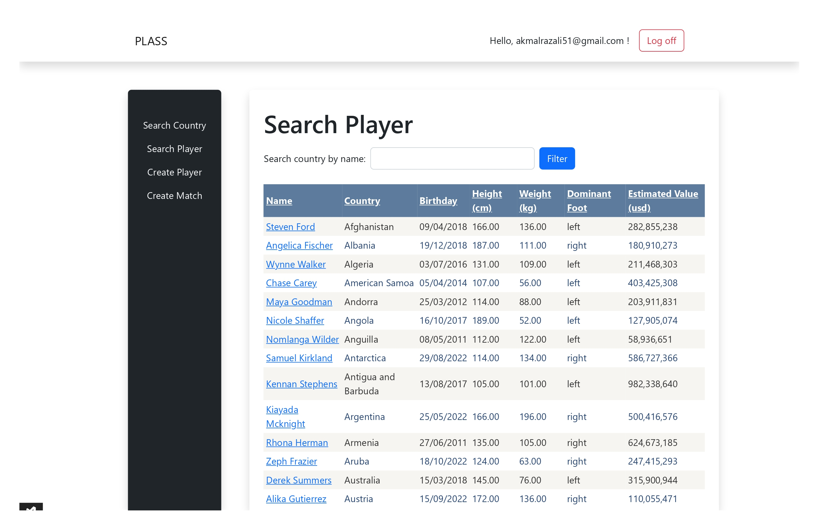
Search Player (1/2)
Steps to search player
Insert player name
Click filter
To search country that participate in FIFA World Cup
1
2
To search player that participate in FIFA World Cup
Create new player for any particular country
Create new match information for any player that participate in this tournament
Click player’s name to view player information

Slide 12
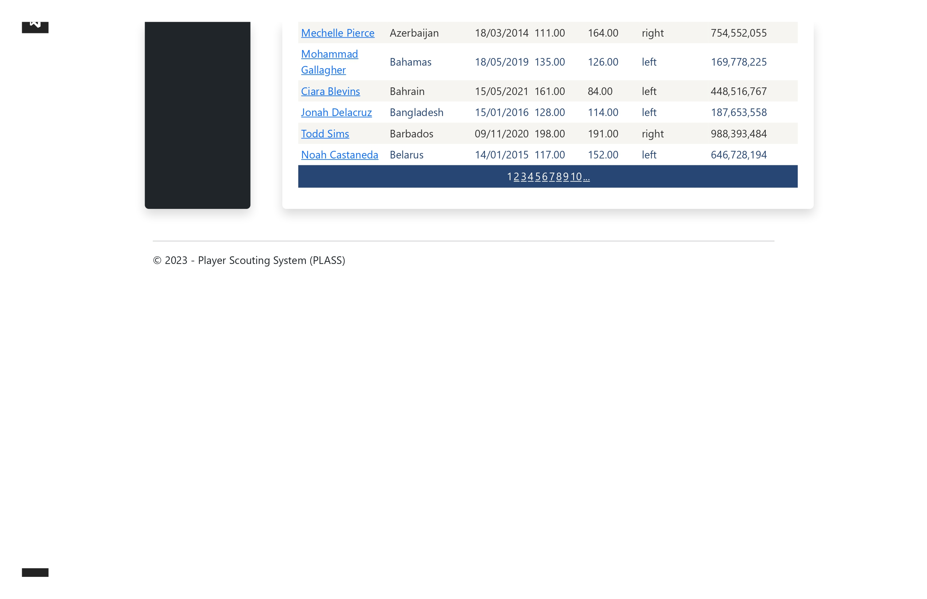
Search Player (2/2)
User can view the to next page by click pagination that were display in this page

Slide 13
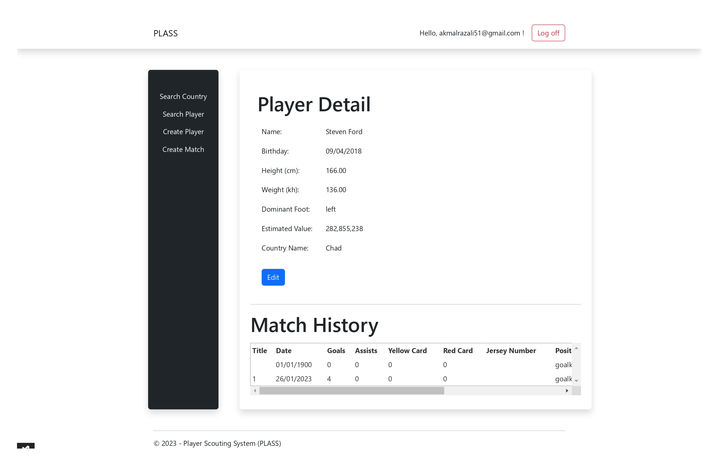
Player Information Details
To search country that participate in FIFA World Cup
Click edit to make amendment on player information details
To search player that participate in FIFA World Cup
Create new player for any particular country
Display match history of the player
Create new match information for any player that participate in this tournament

Slide 14
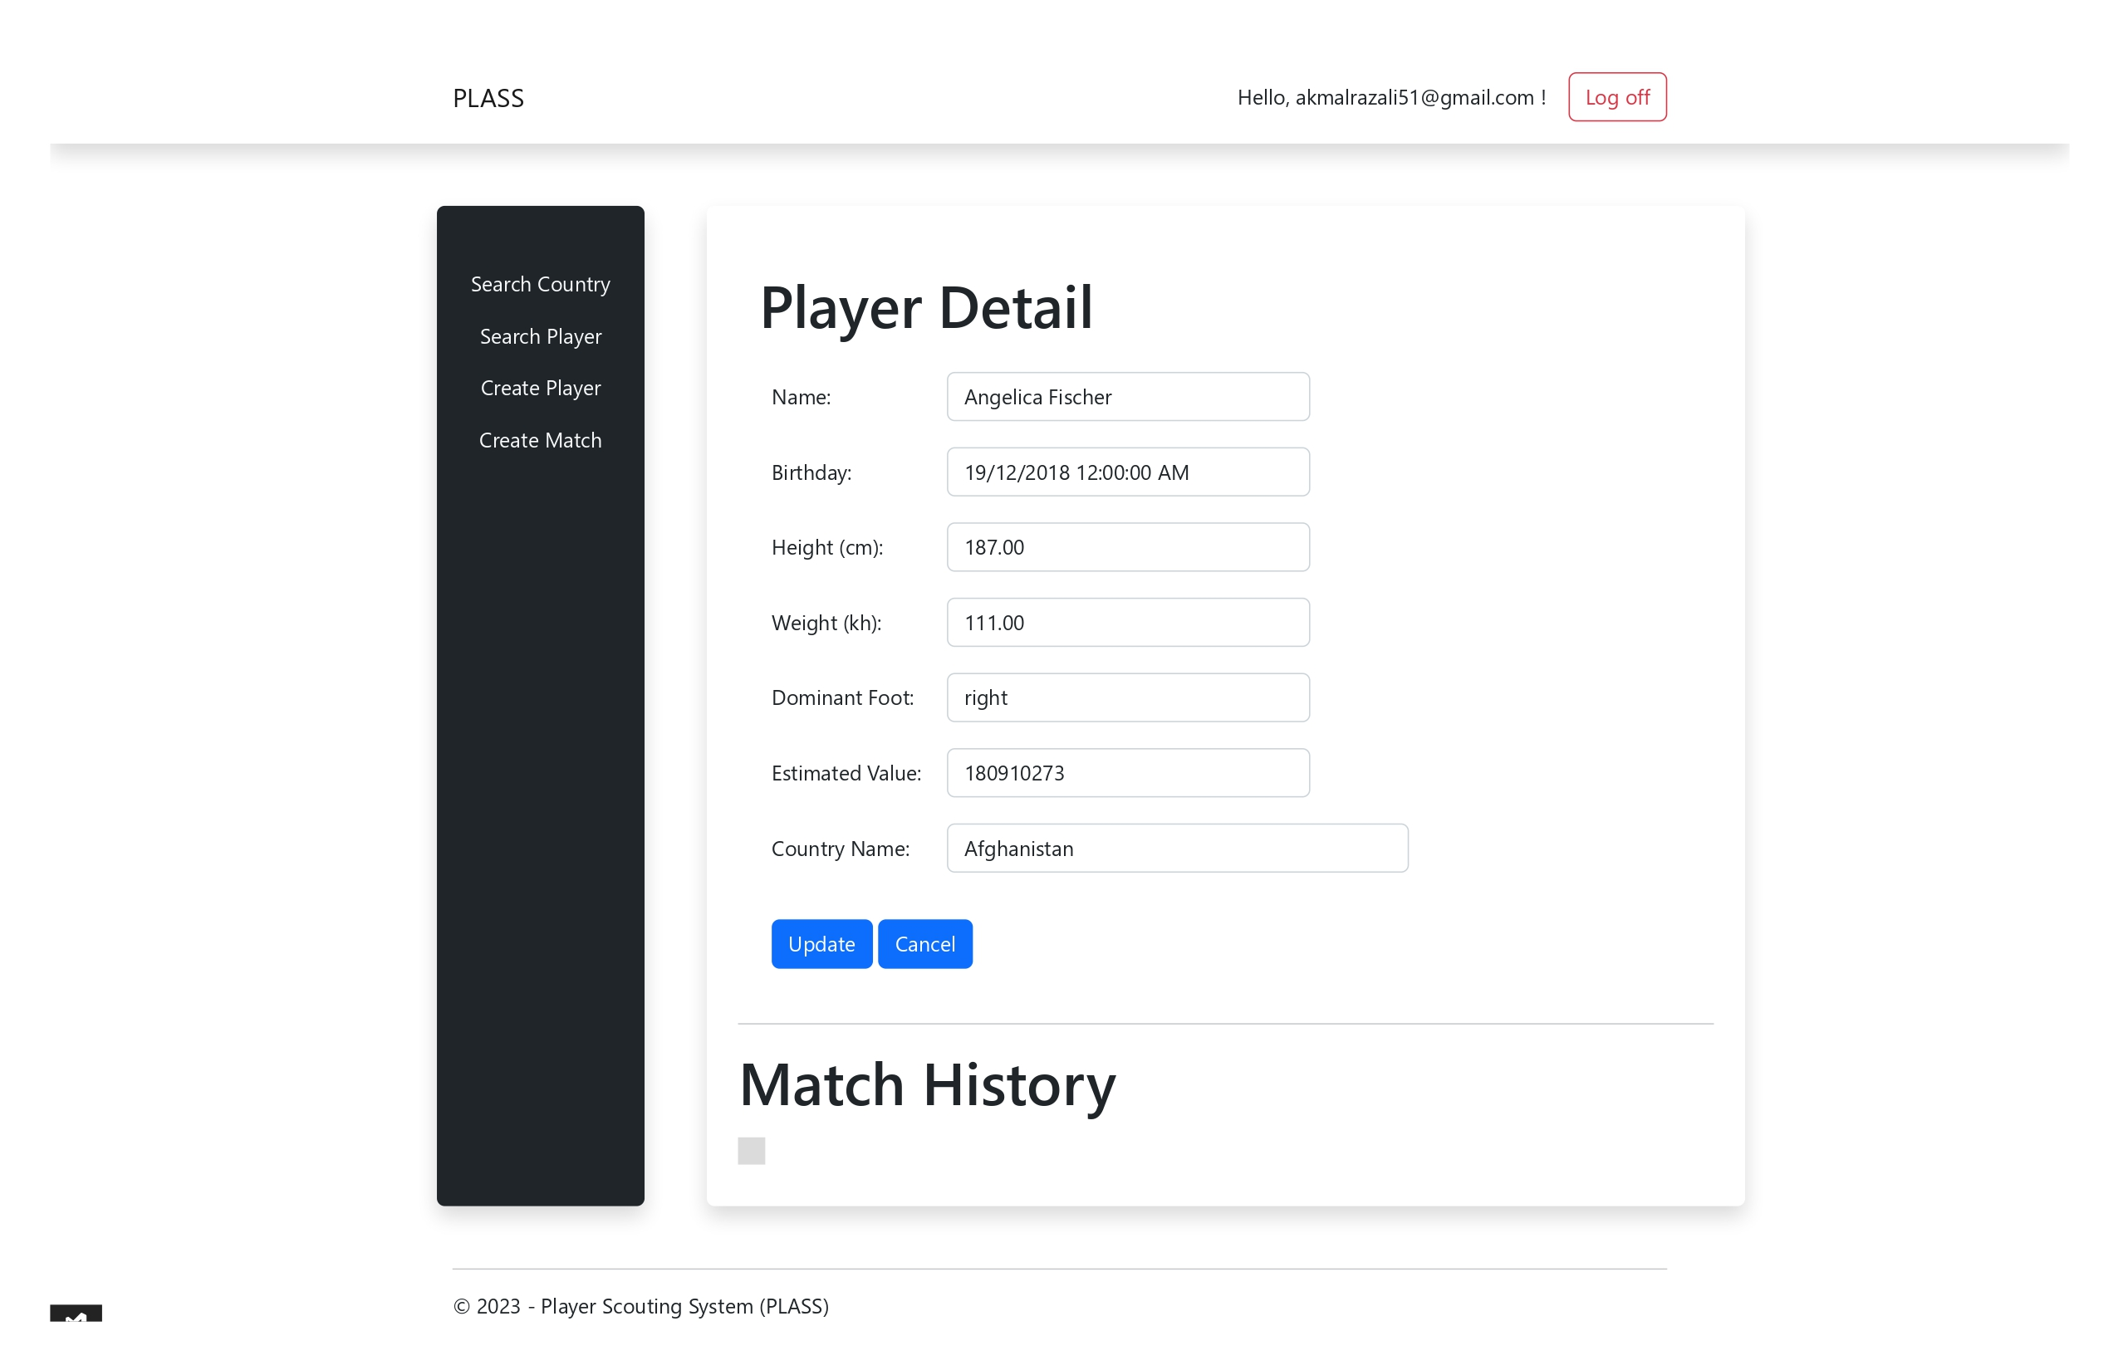
Edit Player Information Details
Steps to edit Player Detail
Make amendment in any column
Click Update to update the information
To search country that participate in FIFA World Cup
1
To search player that participate in FIFA World Cup
User may click cancel if user want to discard all of the amendment that were made by them throughout edit process
Create new player for any particular country
Create new match information for any player that participate in this tournament
2

Slide 15
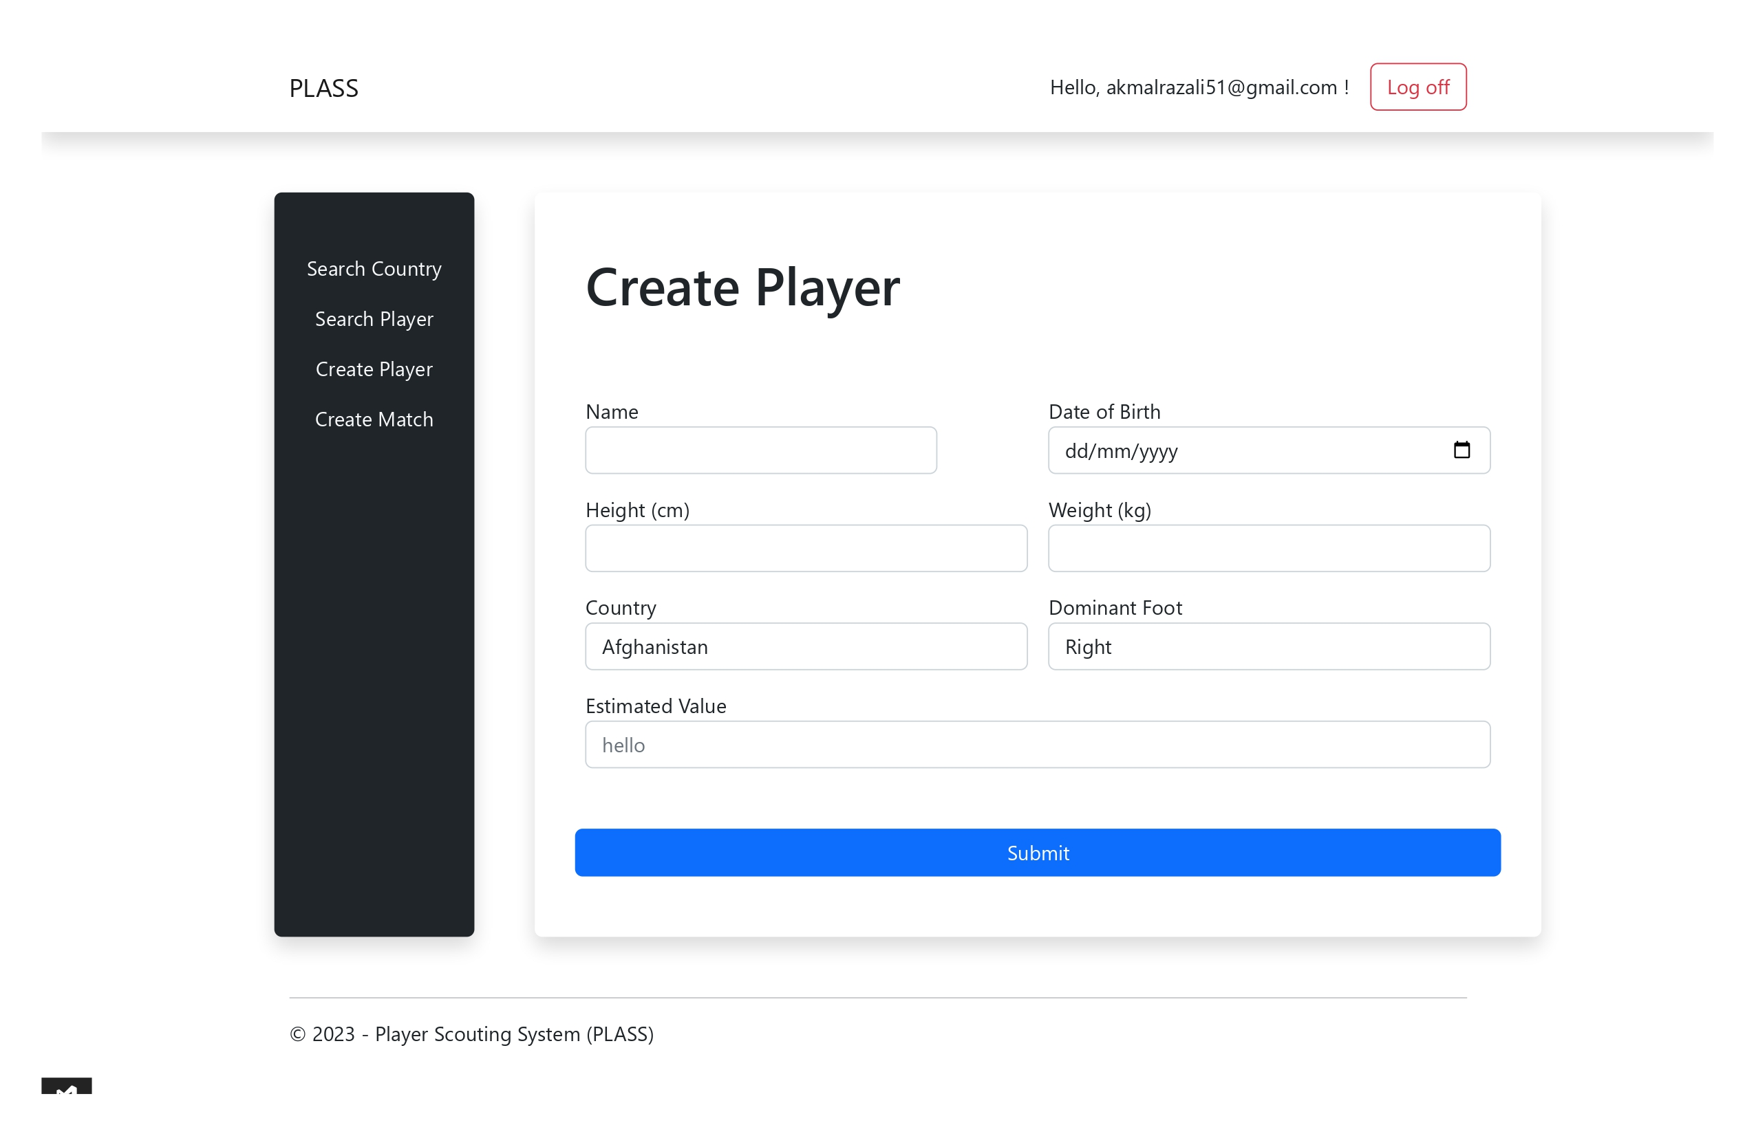
Create Player
To search country that participate in FIFA World Cup
Steps to create player
Insert all details
(**Note that all column are mandatory)
Click Submit
User shall see created player in Player List
To search player that participate in FIFA World Cup
1
Create new player for any particular country
Create new match information for any player that participate in this tournament
2

Slide 16
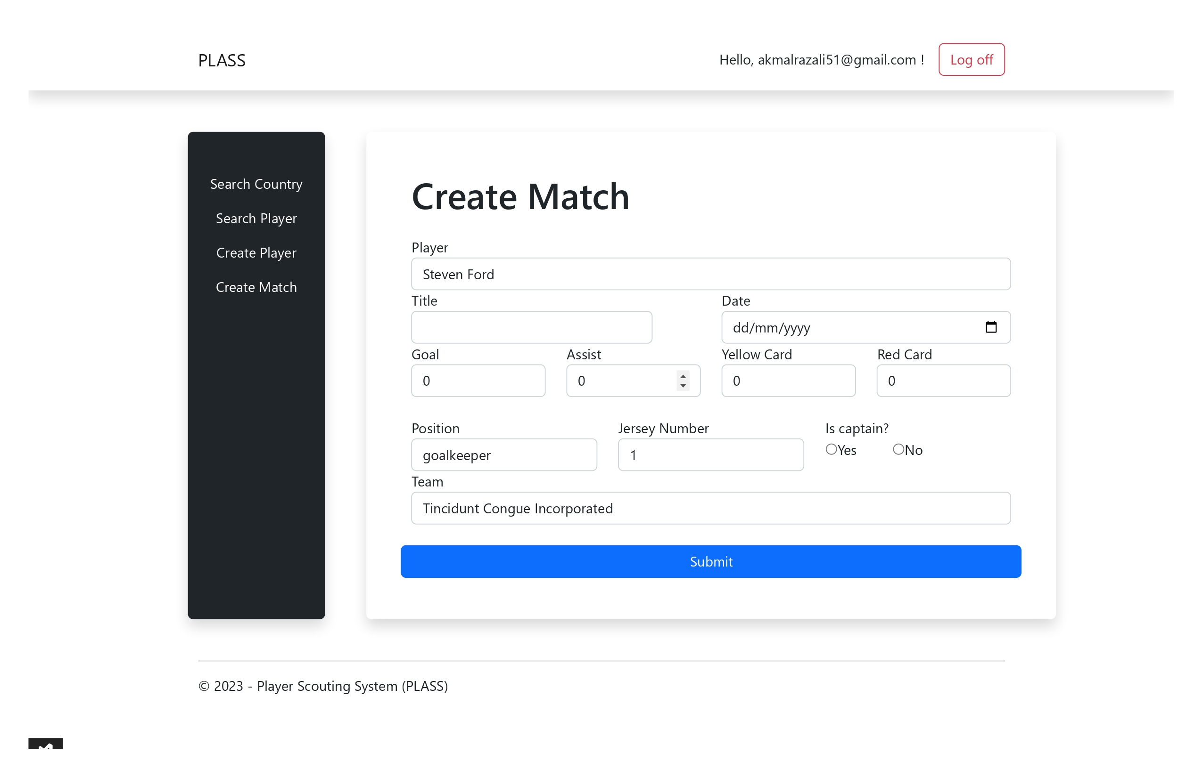
Create Match
To search country that participate in FIFA World Cup
Steps to create match
Insert all details (**Note that all column are mandatory)
Click Submit button
User shall see match in particular player information details
To search player that participate in FIFA World Cup
1
User need to define whether player is the captain or vice versa
Create new player for any particular country
Create new match information for any player that participate in this tournament
2

